Slide 1
wandering
it is common for people with dementia to be found wandering,
lost because of
their loss of ability to recognise familiar places and faces.
lost because of
their loss of ability to recognise familiar places and faces.

Slide 2
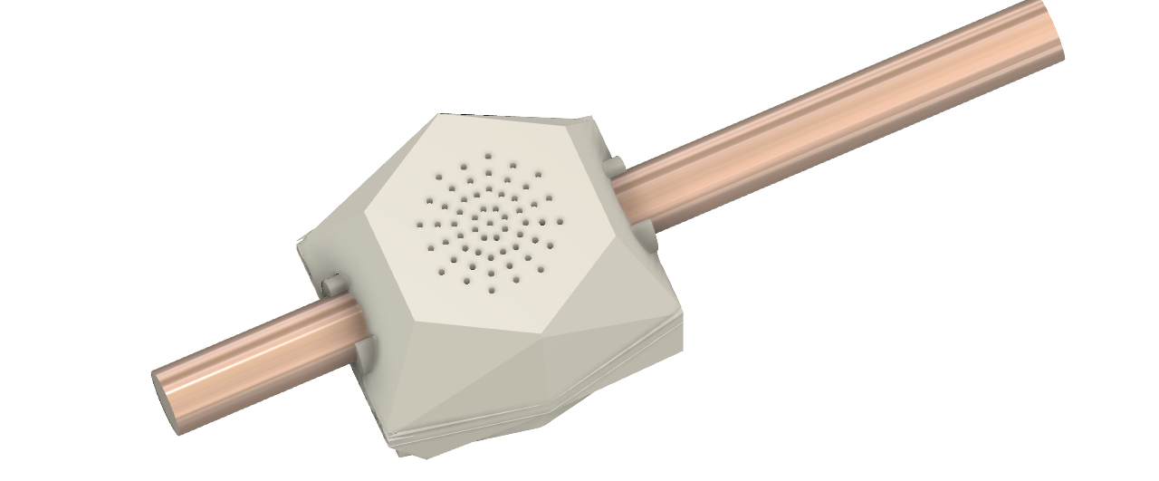

remembering to care for those who forget

Slide 3
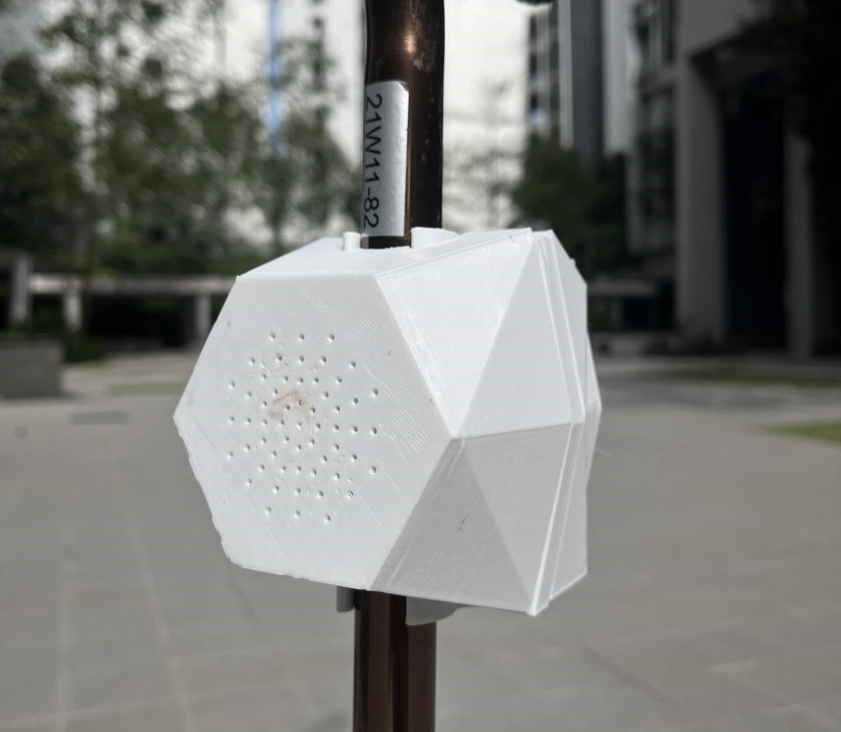


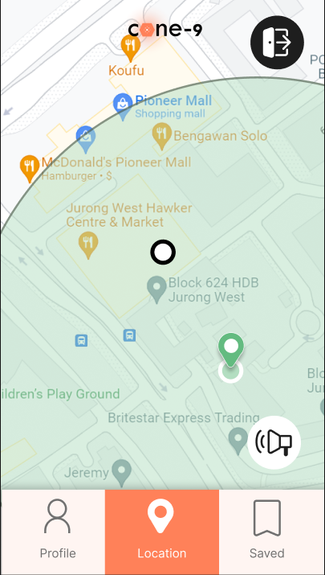
the
solution
the problem
the impact

Slide 4

the problem | the solution | the impact
6 in 10 people with dementia will experience wandering episodes
Alzheimer’s Association
as long as he or she is mobile and is experiencing a declining memory, he or she is vulnerable to this strange but dangerous symptom.
a wandering person with dementia can be a source of distress and anxiety for the caregiver or loved one
Dementia Singapore

Slide 5
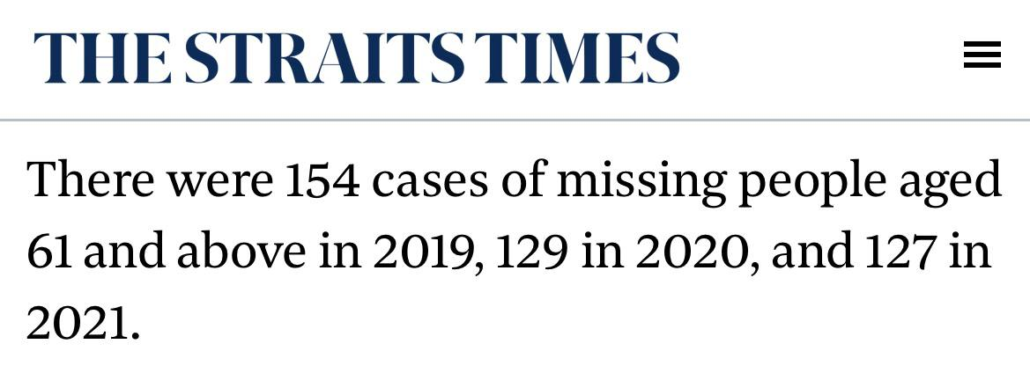
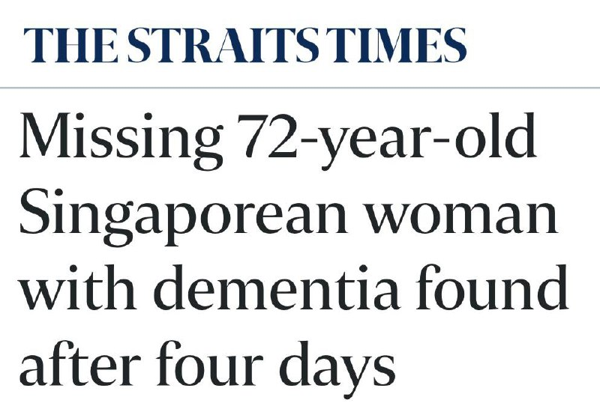
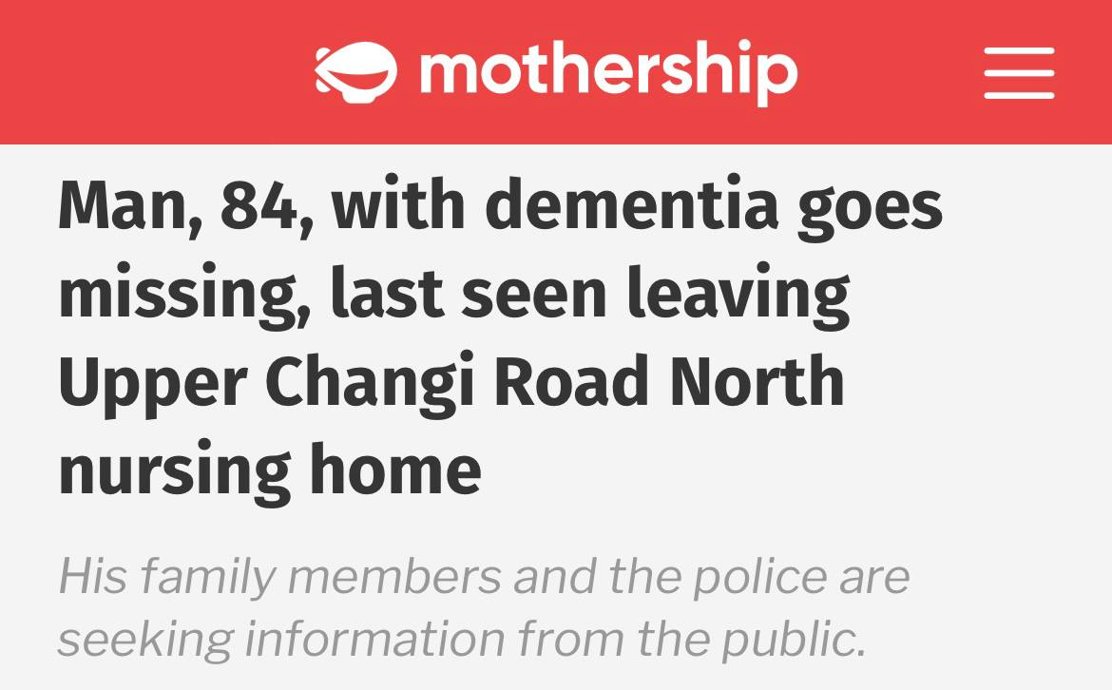
the problem | the solution | the impact
wandering continues to be a pressing issue amongst elderly living with dementia in Singapore.

Slide 6
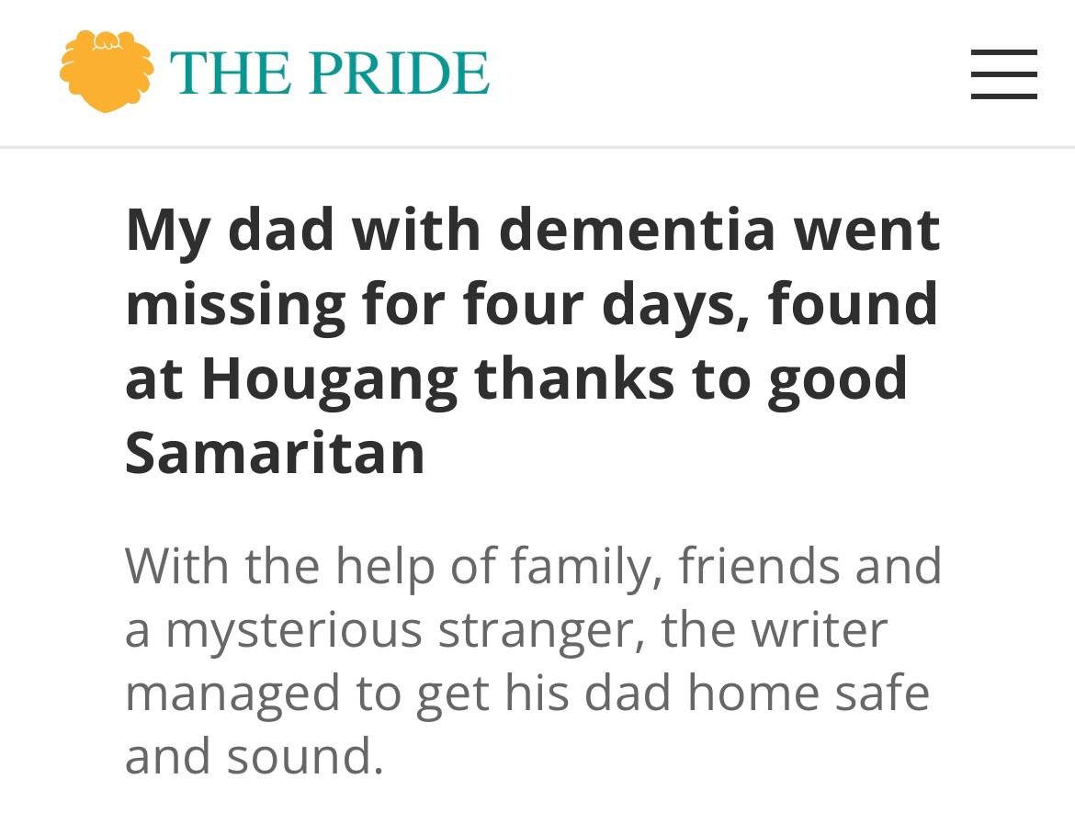
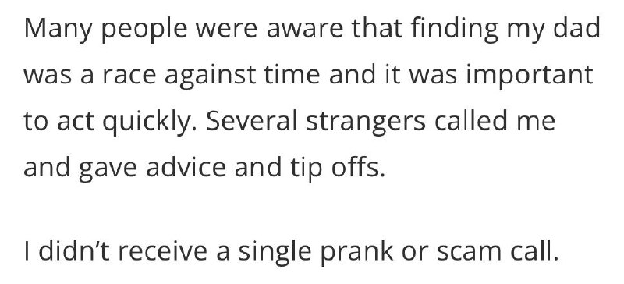
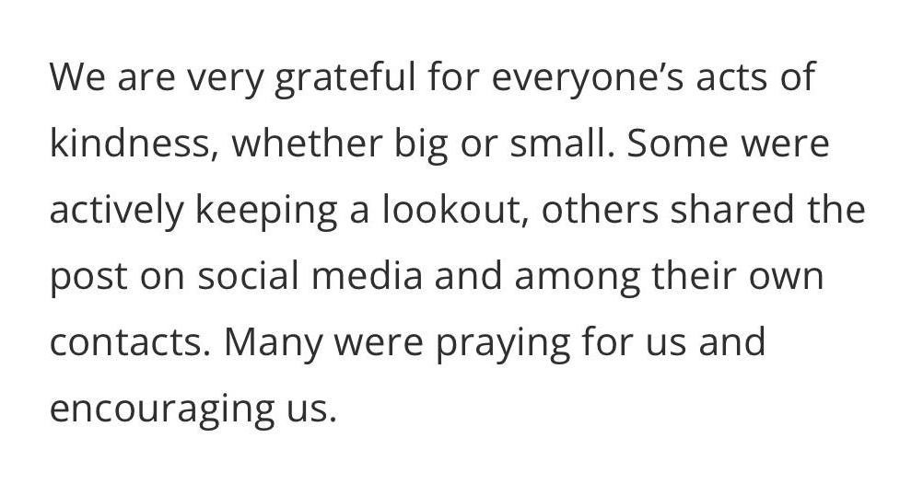
the problem | the solution | the impact
however, amidst these worrying cases, there is some hope and light in the handling of such wandering cases
and that is…
the care from the community

Slide 7

Our Solution
the Cane-9 Walking Cane
the Cane-9
Mobile Application

Slide 8
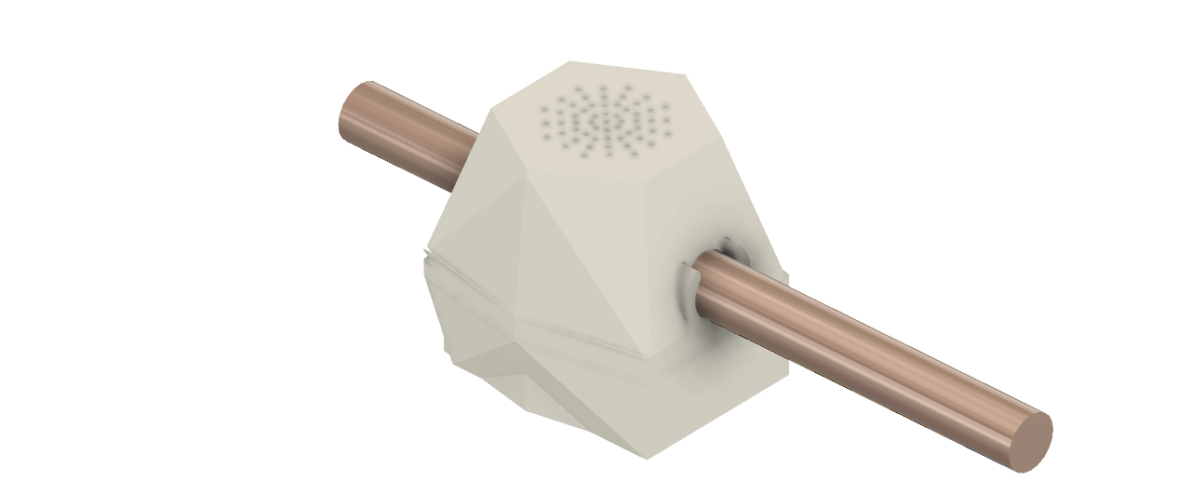
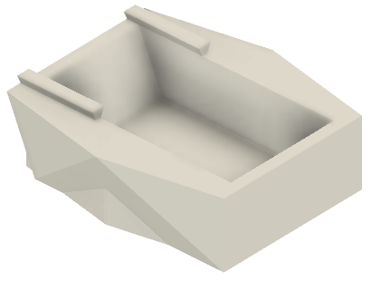


the problem | the solution | the impact

Slide 9
the problem | the solution | the impact
GPS module
Battery
Speaker

Slide 10

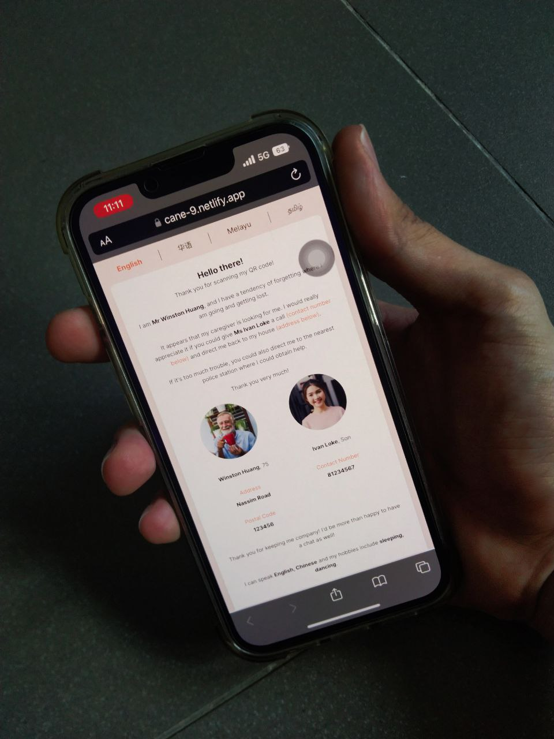
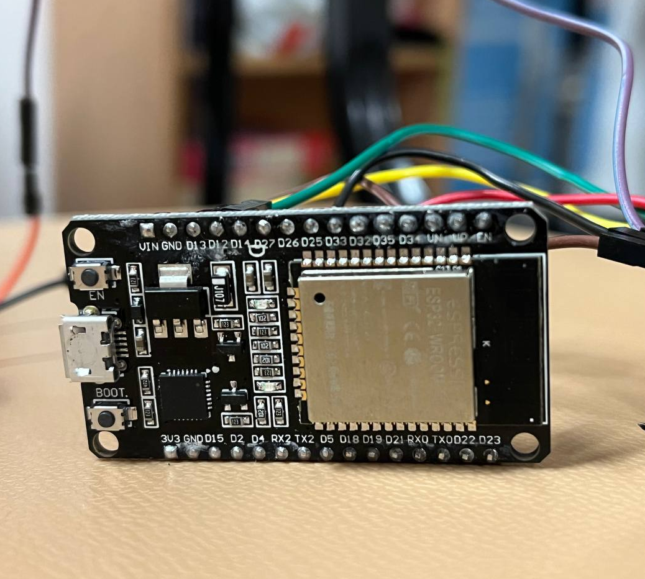
the problem | the solution | the impact
Tech Stack
App
Backend
Web App
Firmware
Flutter
NodeJS, Firebase, Supabase, AWS, PostgreSQL, Express
React, Tailwind CSS
ESP32

Slide 11
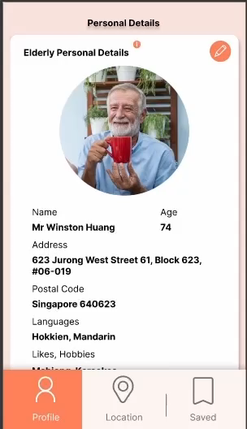
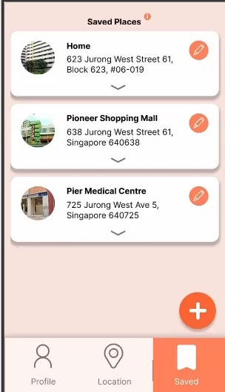
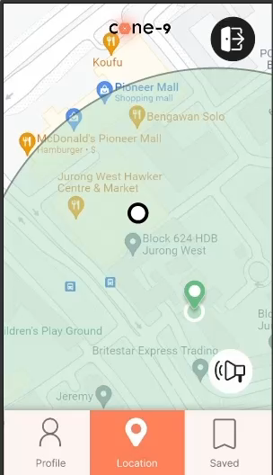
the problem | the solution | the impact
1
Filling in of particulars
Address
Caregiver’s contact
Elderly’s personality traits

Slide 12
the problem | the solution | the impact
2
Saving frequently visited places
These locations will be marked out as ‘Safe Zones’ on our App.

Slide 13
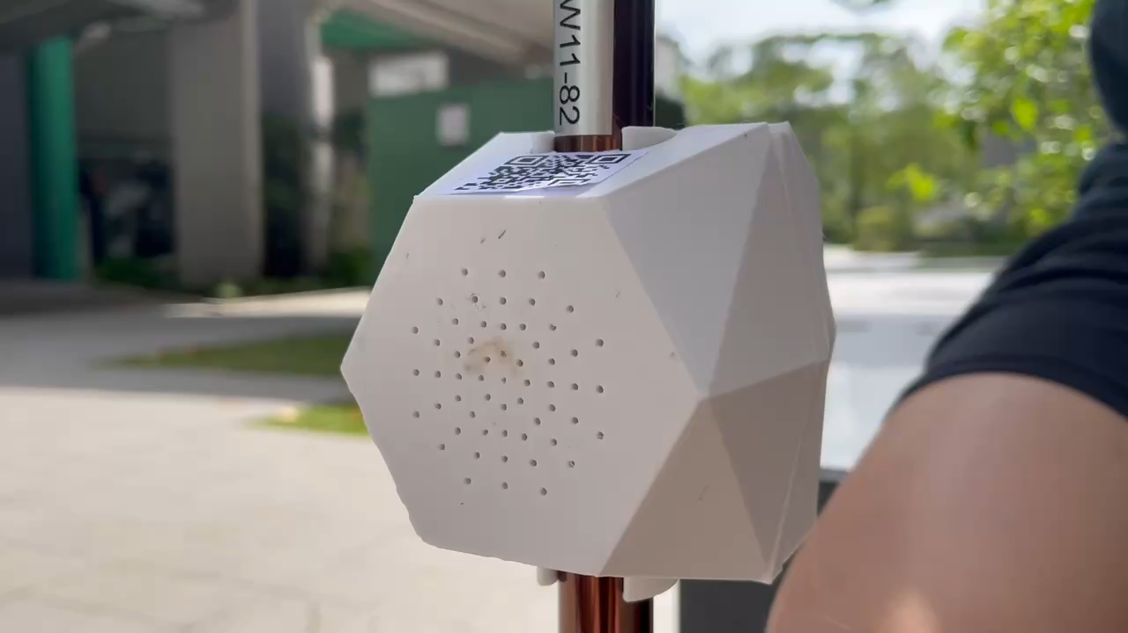
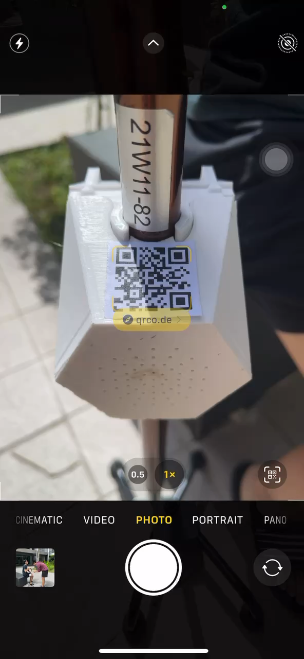
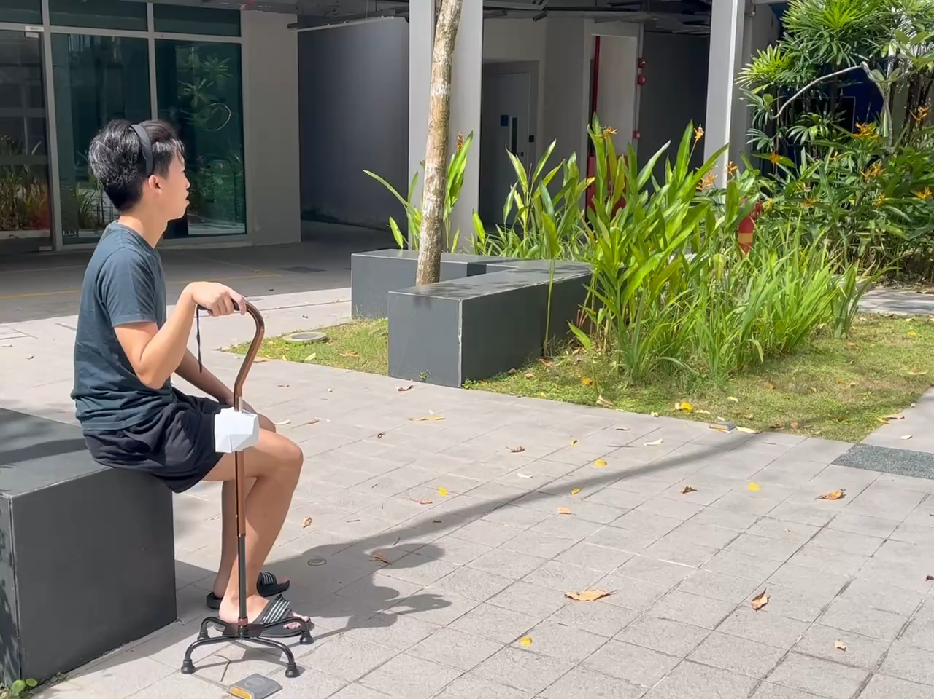
the problem | the solution | the impact
3
GPS tracking of elderly
Caregivers can track the elderly’s whereabouts on the App.

Slide 14
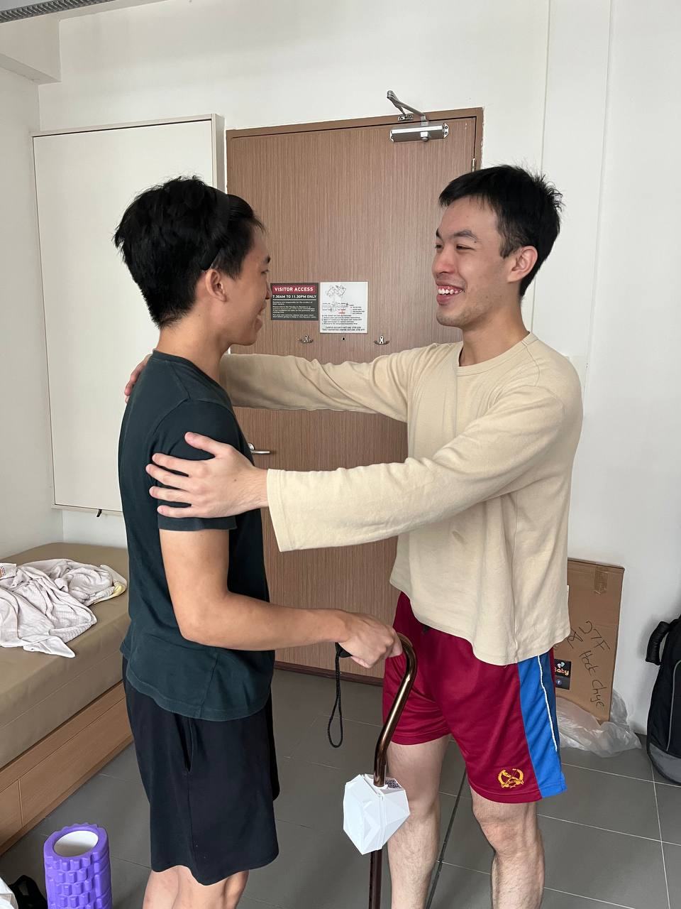
the problem | the solution | the impact
4
Immediate notification if elderly strays
Caregivers receive a phone notification if the elderly has wandered outside of the ‘Safe Zone’.

Slide 15
the problem | the solution | the impact
5
Activating the Cane-9 sound system
Caregivers can then activate the speaker in the Cane-9 via their phone to alert passers-by for assistance.

Slide 16
the problem | the solution | the impact
6
Retrieving contact details
Passers-by who hear the Cane-9’s recording can approach the elderly and scan the QR code to obtain contact and address details.

Slide 17
the problem | the solution | the impact
7
Home, Safe, Home
Passers-by can contact the caregiver, and guide the elderly home or to the nearest public service provider for further assistance.

Slide 18



the problem | the solution | the impact
The Impact
Elderly
Caregivers
Public
Reduce the number of reported cases and duration of missing Elderly with dementia.
Provide Caregivers with more control and relief in caregiving stresses.
Empower the average person to reach out to someone else in need of help.

Slide 19

remembering to care for those who forget

